Slide 1
The Implementation of Value Types
Lawrence Crowl
CppCon 2014
Notes:
Copyright 2014 by Lawrence Crowl.
You have permission to use this work in whole or in part provided that you credit me.

Slide 2
Introduction
(read the notes)
Notes:
These notes will help those who do not listen to the talk.

Slide 3
Definition of Value Types
Identity is not important.
  The address of an object does not affect its operations.
  Operating on a copy of an object is indistinguishable from acting on the original object.
Operations on an object are independent of context.
  All copies are semantically deep copies.
  Operations do not change the context.

Slide 4
Most Familiar Value Types
Built-in arithmetic types are the prototype.
  They have no references to other state.
  They have meaning even when they have no address.
Strings get used as value types.
  Sort of.
  It is complicated.

Slide 5
Attributes of Built-in Arithmetic Types
well-understood operations
efficient operations
well-understood properties
literals
constant initialization
non-type template args
compact representation
efficient copy and move
efficient parameters
relatively alias insensitive
concurrency friendly
heavily optimizable
portable (within limits)
Notes:
The built-in arithmetic types have all sorts of goodness.

Slide 6
Ad-Hoc Representation
int apple_quality = 3;
int orange_quality = 4;
if ( apple_quality + orange_quality ) ...
std::string border = "green";
if ( border == "#00FF00" ) ...
Notes:
Programmers like those attributes so much they insist on using value types all the time, but often only the existing value types. They layer their meaning as ad-hoc conventions on existing types.
These conventions are unenforceable because there is no abstraction on which to attach enforcement.

Slide 7
Why not new value types?

Slide 8
FEAR

Slide 9
Concerns with Abstraction
It will be too slow.
It will take too long to write.
It will have bugs.
It will take too long to learn.
It will not do what is expected.
It will not be available elsewhere.
Notes:
The concerns boil down to "It will not be as good as a built-in value type".

Slide 10
Overcome the Fear
Notes:
Address the concerns in the definition of the type.
Make the type bullet proof.

Slide 11
Operations
Notes:
The first step in building a value type is knowing what you want to do with it.

Slide 12
Mission Creep
cardinal numbers + subtraction => integers.
  New representation.
integers + division => ???
  commercial: same representation, redefined division
  engineering: floating point, approximate division
  mathematical: rational, accurate division
Notes:
Every operation you add to a type may change representation or performance.
So, choose them carefully.

Slide 13
Operation Categories
Must Have
Nice to Have
Exuberant Generalization
Foolish Consistency
Notes:
Figure out the category each operation.
Implement the must-have.
Implement the nice-to-have that do not affect representation or other operations.
Ignore the rest.

Slide 14
Properties
Notes:
There are many properties of a type that, while not obvious in the implementation, can have a large effect on the usability of the type.

Slide 15
Mathematical
Idempotent?
Identities?
Zeros?
Commutative?
Distributive?
Totally ordered?
Strictly weakly ordered?
Partially ordered?
Notes:
Deciding up front which mathematical properties apply to your operations can reduce surprises later.
In particular, many parts of the standard library require types to be at least strictly weakly ordered. If you do not do that, you should be clear to both yourself and your customer.

Slide 16
Representational
Are there trap values?
Do all bit patterns in the implementation represent a value?
Are they distinct values?
Notes:
Types produce the least surprise when all bit patterns represent distinct values. That is, however, not always possible or desirable.

Slide 17
Semantic
Is ill-formed use detectable?
  If so, is it desirable?
  In debugging?
Have you mixed concepts of a container and a value?
  std::string
Notes:
The standard string has caused the committee quite a bit of trouble because folks want to use it like a value, but it was designed as a container. This dichotomy has had several unpleasant concurrency and performance characteristics.

Slide 18
Syntactic
Are operators appropriate and consistent with conventions?
Do you want free functions for symmetric argument conversion?
Does the associativity of the operator match efficient association?
Notes:
Take care to examine how users write code using your type.

Slide 19
String Append
string a, b, c, d;
a += b += c += d;
// a += (b += (c += d));
((a += b) += c) += d;
a << b << c << d;
Notes:
The right associativity of the assignment operator is at odds with the left associativity of the append operation.
Better is the left-associative shift operator, as was done in the stream class.

Slide 20
Generality
Notes:
The arithmetic types can be used in places that many regular classes cannot. We would like to be able to use other value types in those places.

Slide 21
Literal Types
May be used to define compile-time constants.
May be used to compute array sizes.
May be used as non-type template arguments.
Notes:
The primary mechanism for that generality is literal types.

Slide 22
Literal Types
A literal type is
  a scalar type,
  a reference type,
  an array of literal type,
  or a literal class type.
Literal class types:
  have only literal types for non-static data members and bases;
  is an aggregate or has at lest one constexpr constructor
  that is not a copy or move constructor;
  and have a trivial destructor.
Notes:
The requirements for a literal type are a bit complicated, but generally not onerous for "small" types.

Slide 23
Literal Values
probability operator""_p(long double v) {
return probability(v);
}
probability x;
probability y = x * 0.3_p;
Notes:
User-defined literals, aka literal operators, enable you to support literal values.
It can be ... challenging to provide a constexpr literal operator.
Take care to firewall your name environment because you will be competing with everyone else for short literal suffixes.
The standard has an example of using a user-defined literal for units of measure. The mechanism is a poor match for that use.

Slide 24
Representation
Notes:
Your type representation can have a large influence on usability and performance.

Slide 25
Redundancy
template <typename T>
struct read_mostly_complex {
T real, imaginary;
T angle, magnitude;
....
};
Notes:
It will not surprise you when I say avoid redundancy. However, some redundant representations can yield better performance. Some complex number operations are faster in a polar representation, others in a cartesian representation. For complex numbers that are mostly read, keeping both representations will be more efficient. Redundancy can also help with consistency checking.

Slide 26
Padding
double, int64_t, long long
pointer
long
float, int32_t, char32_t
int
int16_t, char16_t, short
char
long double
ptrdiff_t
size_t
Notes:
Avoid padding in your types.
Order types from large alignment/size to small.
The left column is pretty commonly ordered this way.
The right column is more problematic.
In extreme cases, test with the preprocessor.

Slide 27
Hotness
Cache use has a large impact on performance.
Minimize the number of cache lines your type typically uses.
Put hot and cold fields on different cache lines.
Put fields accessed together on the same cache line.
Notes:
Sometimes much of the data in a type is mostly unused. Reduce the impact of that data on performance by putting it together out of the way..

Slide 28
Copy and Move
Notes:
Copying and moving data is a major cost on modern systems.

Slide 29
Trivially Copyable
Basic types are trivially copyable.
Contents can be bit-blasted.
Contents can be passed in registers.
It is testable:
  #include <type_traits>
  std::is_trivially_copyable<TYPE>::value ? ....
Notes:
The best thing you can do for copy performance is to make it trivial. The machine is fastest when copying an undifferentiated block of bits.

Slide 30
Requirements
Fields are all trivially copyable.
There are no non-trivial (copy or move) (constructors or assignment operators).
The destructor is trivial.
There are no virtual bases or functions.
Notes:
The requirements for trivially copyable are detailed, but generally not onerous for small types.

Slide 31
What if the type is big?
Locality of access is often more important than space efficiency.
  But not always.
Notes:
Live with it.
Accessing two words on each of two different cache lines is likely slower than accessing four words on one cache line.
Sometimes, accesses are so rare that a side table is the better bet.

Slide 32
What if your type is too big?
Implement logical copying without physical copying via copy on write.
Reference counting works well for non-circular structures.
  But make sure your reference counting is thread friendly.
Improve locality by embedding small values rather than reference counting.
Notes:
Even if you do not copy, you want the type to behave as if it had been copied.

Slide 33
Moving
type(const type& a)
: p(new content(*a.p)) {
}
type(type&& a)
: p(a.p) {
a.p = std::nullptr;
}
Notes:
Adding move constructors and assignment operators can substantially reduce the cost of temporary variables.
It is appropriate when the value type manages heap storage, particularly large dynamic structures.
The compiler will recognize when moving is a good idea and call your move function.
It avoids some allocate, copy, and deallocate and associated reference counting.

Slide 34
Parameter Passing
Notes:
Parameter passing is a major cost in programs that have good abstraction.

Slide 35
Two Choices
Pass by value.
Pass by const reference.
Notes:
Traditionally, nearly every class has been passed by const reference. That choice is not always best.

Slide 36
Slicing
class B {
virtual bool d() { return false; } };
class D : B {
virtual bool d() { return true; } };
bool g( B a) { return a.d(); }
bool h(const B& a) { return a.d(); }
g(D()) == false && h(D()) == true
Notes:
Changing the parameter mechanism can change the behavior.
It may or may not be what you want.
It matters only with virtual functions.
Virtual functions can deliver the same logical value through different algorithms on adaptive representations.

Slide 37
Pass by Value
extern type va1(type input);
extern type va2(type input);
void vf1(type& output, type input) {
output += va1(input);
output += va2(input);
}
Notes:
This code does what you want.
The implementation is defined by the platform's ABI.
Execution costs for smaller types can vary substantially between platforms.

Slide 38
Direct Pass by Value
Requires a trivially copyable class.
Copy argument to the stack (e.g. IA32).
  Work is equivalent to a memcpy.
Copy small arguments to a register (e.g. AMD64).
  May spill argument registers.
Do neither (e.g. SPARC32).
  Instead use indirect pass by value.
Notes:
A direct implementation is best when feasible.

Slide 39
Indirect Pass by Value
Works with non-trivally copyable types.
Allocate a temporary local variable of the type.
Copy the argument to the temporary.
Pass a pointer to the temporary into the function.
Access the content of the parameter indirectly.
Deallocate the temporary on return.
Notes:
Indirect passing is the fallback. Since access is indirect, it is generally slower.

Slide 40
Pass by Const Ref
extern type ra1(const type& input);
extern type ra2(const type& input);
void rf1(type& output, type& input) {
output += ra1(input);
output += ra2(input);
}
Notes:
Indirect memory access.
Errors due to unintended aliasing. In this case, the function will likely fail if input and output are the same object.
Performance loss due to supporting possible intended aliasing.

Slide 41
Parameter Recommendations
Pass by value when the type is
  small (<= 2 pointers) and
  trivially copyable.
Pass by const ref when
  the type is large and
  alias detection is relatively cheap.
Otherwise do some experiments.
Notes:
Const ref is common practice, so you will not likely get in trouble for it.

Slide 42
Result Passing
Notes:
Aliasing is a major source of bugs and a major inhibitor to performance.

Slide 43
Return by Value!
Notes:
Returning by value is the best thing you can do for code clarity.

Slide 44
Named Return Value Optimization
type function(....) {
type result;
....
if ( .... ) {
....
return result;
}
....
return result;
}
Notes:
Always write you function to enable the named return value optimization. It is among the best things you can do for performance.

Slide 45
Aliasing
Notes:
Aliasing is a major source of bugs and a major inhibitor to performance.

Slide 46
Approaches
Ignore the problem.
Document the problem.
  List possible overwrites in the comments.
  Use the restrict qualifier that C++ does not have.
Overcome the problem.
Notes:
The programmer of a type is in the best position to eliminate aliasing problems.

Slide 47
Copy a Potentially Aliasing Parameter
void rf3(type& output, const type& input) {
type temp = input;
output += rf1(temp);
output += rf2(temp);
}
Notes:
This solution is no better than simply declaring a value parameter. However, it is useful when legacy interfaces require preserving reference parameters.

Slide 48
Conditionally Copy
void rf3(type& output, const type& input) {
if ( &output == &input ) {
type temp = input;
output += rf1(temp);
output += rf2(temp);
} else {
....
}
}
Notes:
We can detect and directly code around the alias. The solution introduces a comparison and more code, but both the comparison and the code can often be removed by compilers when the inlining the code.

Slide 49
Conditionally Do Not Copy
type& type::operator =(const type& a) {
if ( this != &a ) {
delete p;
p = new content(*a.p);
}
}
Notes:
The most common aliasing detection today is used to avoid failing when assigning an object to itself.

Slide 50
Order Reads Before Writes
void rf4(type& output, const type& input) {
type temp1 = ra1(input);
type temp2 = ra2(input);
output += temp1;
output += temp2;
}
Notes:
Introducing temporaries to delay writes until after all reads can be effective. Often those temporaries will just name what the compiler would have created anyway.

Slide 51
Aliasing Fields
template <typename T>
T& complex<T>::operator *=(const T& a) {
real = real * a.real - imag * a.imag;
imag = real * a.imag + imag * a.real;
return *this;
}
Notes:
This code is broken when multiply-assigning a number to itself.

Slide 52
Read Caching Fields
template <typename T>
T& complex<T>::operator *=(const T& a) {
T a_real = a.real, a_imag = a.imag;
T t_real = real, t_imag = imag;
real = t_real * a_real - t_imag * a_imag;
imag = t_real * a_imag + t_imag * a_real;
return *this;
}
Notes:
You can cache individual fields to avoid aliasing.
Why can't the compiler do this transformation? You might want this interference!
This approach also helps the compiler produce better code even in the absence of aliasing.

Slide 53
Conflicts
Notes:
Value types should not interfere with each other and the environment. Sometimes that requires explicit attention.

Slide 54
Global State
Changes to global state must not affect logical operation results.
  Access to constant state is fine.
  Memory allocation is fine.
  Physically shared state must be protected against concurrent access.
Operations must not affect global state.
  Physically shared state must be protected against concurrent access.
I/O only for debugging and performance analysis.
Notes:
Do not make users think about global state when doing operations on value types.

Slide 55
Static Initialization Order
constexpr type::type(int arg)
: field(arg) { }
type v(3);
Notes:
There are few guarantees on the order of static initialization.
Strive for constant initialization to prevent surprises.
Provide a constexpr value constructor.
When called with constant arguments on a global, the initialization will be constant, i.e. static.
Unfortunately, there is no syntax for getting a warning when the initialization is not static.

Slide 56
Concurrency
Reduce aliasing otherwise.
Make const reference parameters concurrent-read safe.
  The deep argument is only read in all operations, or
  any access is protected with locks or atomics.
Notes:
We will see more and more concurrency in C++. Prepare for it now.
Concurrent-read safe is a requirement that the standard imposes on its library, but it is not required on user code. Still, you are well advised to meet that requirement.

Slide 57
Exceptions
Where possible, make operations noexcept.
Otherwise, make operations exception safe.
  An exception leaves the object in the state it had at the beginning of the operation..
Notes:
Value types should generally avoid throwing exceptions, but sometimes you must and sometimes they bubble up from implementation details. If so, make the operations exception safe.

Slide 58
Allocate Before Changes
type& type::operator =(const type& a) {
if ( this != &a ) {
content *q = new content(*a.p);
delete p;
p = q;
}
}
Notes:
Earlier example of protecting against assigning this to this was broken. If the allocation failed, the original data was lost. This fixes that problem.

Slide 59
Recover Resources
type& type::operator =(const type& a) {
if ( this != &a ) {
content *q = new content(*a.p);
try {
delete p;
} catch ( ... ) {
delete q;
rethrow;
}
p = q;
}
}
Notes:
Unfortunately, the previous fix added another problem. We leak memory if the delete fails. So now we must delete q when delete p does fail.

Slide 60
Optimization
Notes:
Optimization is a partnership between you and the compiler. Partnerships work best when you concentrate on different tasks.

Slide 61
Responsibilities
You
  choose the representation;
  implement the operations;
  reduce aliasing; and
  reduce memory accesses.
The compiler
  does most everything else.
Notes:
Compilers are very good these days, so concentrate on changing things that the compiler is not allowed to change.

Slide 62
Avoid Redundant Memory Access
Loading a pointer twice is inefficient unless you are waiting for someone else to change it.
The keyword this is an implicit pointer and inhibits optimization.
  Aggressively cache field reads.
  Write back cached field.
Notes:
Essentially, we are reducing the amount of aliasing, which allows the compiler to do a better job.

Slide 63
Inlining
Inlining may be a long-term commitment.
Constexpr implies inlining.
Inlining increases code bloat and puts pressure on the cache.
Inline when the body is no bigger than the call.
Otherwise, inline when you have evidence of performance gains.
Notes:
Inlining is the biggest decision that you would rather not make. ABI issues may prevent changes. Performance is erratic. Compilers hide consequences.

Slide 64
Portability
Notes:
We have all heard that portability is good.

Slide 65
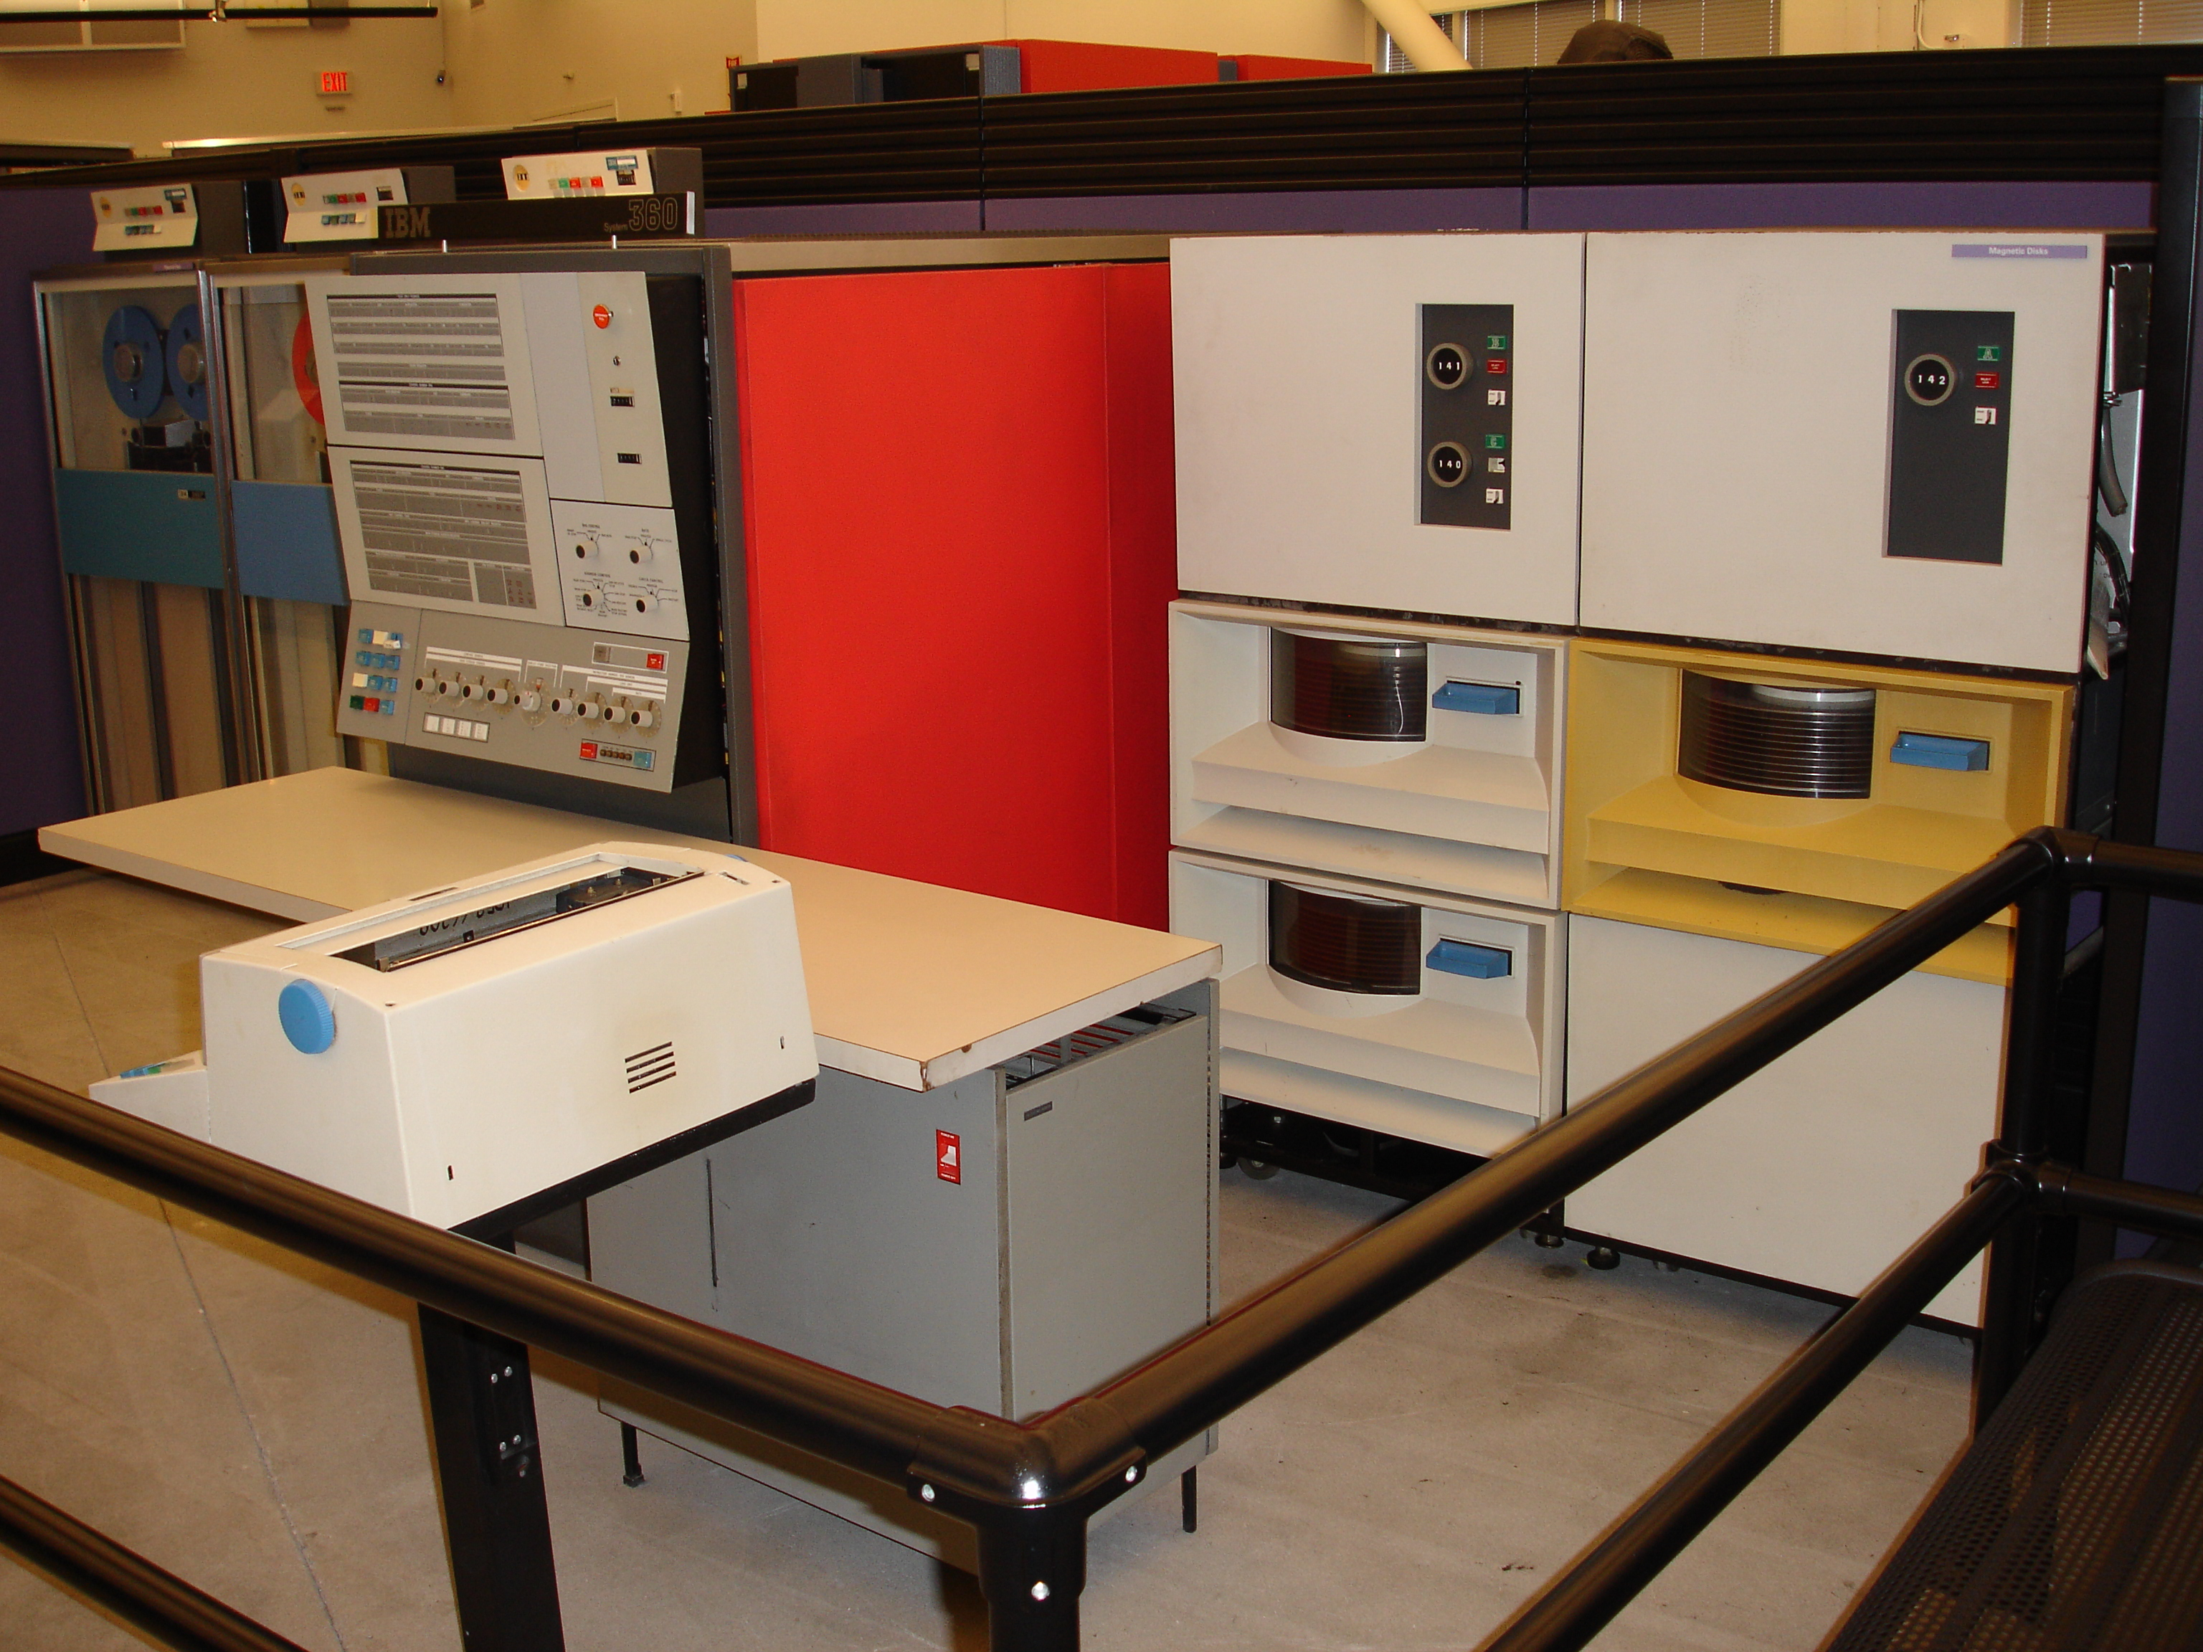
IBM System\360
Notes:
Do not worry.
IBM's System\360 family of computers handles all your needs.
business
technical
large
small
All other architectures will fade.
You will have no need to ever port your code.
"IBM System360 Model 30" by Dave Ross - Flickr: IBM System/360 Model 30. Licensed under Creative Commons Attribution 2.0 via Wikimedia Commons - http://commons.wikimedia.org/wiki/File:IBM_System360_Model_30.jpg#mediaviewer/File:IBM_System360_Model_30.jpg

Slide 66
Follow Along
Follow the standard.
Follow the compilers.
Follow the authors.
Follow the tools.
Notes:
Conform to the formal requirements on programs.
Aim for compilers a bit behind the standard.
Authors often write so you do not need to suffer.
Tools that check your code can eliminate latent errors and save lots of time and money.

Slide 67
Choose Portable Types
int64_t num_humans;
for ( size_t i = 0; i < v.size(); ++i )
.... v[i] ....;
int c = getchar();
Notes:
Use stdint types for representing user data.
Use size_t types for indicies and sizes.
Use legacy types for interacting with existing APIs.

Slide 68
Summary

Slide 69
Invest
A good value type takes time to develop.
  operations, properties, generality
  representation, copy and move, parameters, results
  aliasing, conflicts, optimization, portability

Slide 70
Profit
Reduced client development time.
  Semantics are clarified early.
  Many mistakes are caught earlier.
  Abstraction handles help debugging.
Reduced execution costs.
  Better implementations.
  Abstraction handles help performance analysis.

Slide 71
Share
Code sharing websites
Articles, talks and tutorials
Boost
C++ Technical Specifications
The C++ Standard
Notes:
You have developed and profited from a great value class. Consider sharing that achievement with the rest of the world!

